Slide 1
SORTEDLIST

Slide 2
What is SortedList
The Non-Generic SortedList Collection Class in C# represents a collection of key/value pairs that are sorted by the keys and are accessible by key and by index. By default, it sorts the key/value pairs in ascending order.
Properties of Non-Generic SortedList Class in C#:
The Non-Generic SortedList Class in C# implements the IEnumerable, ICollection, IDictionary, and ICloneable interfaces.
We can access the element by its key or by its index in SortedList.
The Non-Generic SortedList object internally maintains two arrays to store the elements of the list, i.e, one array for the keys and another array for the associated values. Here, the key cannot be null, but the value can be null. And one more, it does not allow duplicate keys.
The capacity of the Non-Generic SortedList object is the number of key/value pairs it holds.
In the Non-Generic SortedList object in C#, we can store values of the same type and of the different types as it operates on the object data type.
In the same SortedList, it is not possible to store keys of different data types. If you try then the compiler will throw an exception.

Slide 3

How to Create a SortedList
SortedList(): It initializes a new instance of the System.Collections.SortedList class that is empty, has the default initial capacity and is sorted according to the IComparable interface implemented by each key added to the System.Collections.SortedList object.

Slide 4
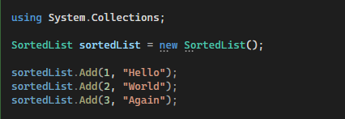
How to Add Elements into a SortedList
If you want to add a key/value pair to a SortedList, then you need to use the Add() method of the SortedList class.
Add(object key, object value): The Add(object key, object value) method is used to add an element with the specified key and value to a SortedList. Here, the parameter key specifies the key of the element to add and the parameter value specifies the element to add. The value can be null

Slide 5
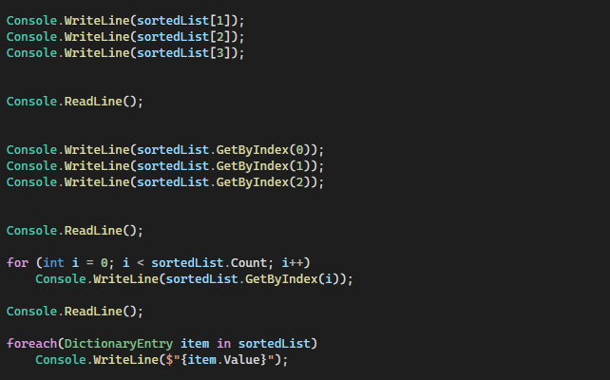
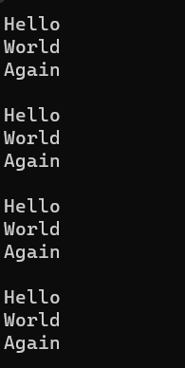
Accessing items in SortedList

Slide 6
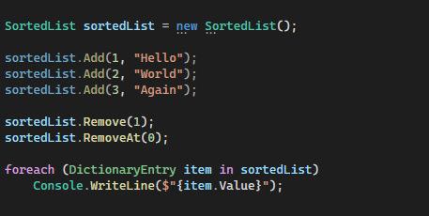

How to Remove Elements from a SortedList Collection
The Non-Generic SortedList Collection Class in C# provides the following methods to remove elements from SortedList.
Remove(object key): This method is used to remove the element with the specified key from a System.Collections.SortedList object. The parameter key specifies the element to remove.
RemoveAt(int index): This method is used to remove the element at the specified index of a System.Collections.SortedList object. The parameter index specifies the element to remove. It is 0 based Index.
Clear(): This method is used to remove all elements from a System.Collections.SortedList object.

Slide 7
How to check the availability of key/value pairs in a SortedList
If you want to check whether the key/value pair exists or not in the SortedList, then you can use the following methods of the SortedList class.
Contains(object key): This method is used to determine whether the SortedList object contains a specific key. The parameter key to locate in the SortedList object. It returns true if the SortedList object contains an element with the specified key; otherwise, false. If the key is null, then it will throw System.ArgumentNullException.
ContainsKey(object key): This method is used to determine whether a SortedList object contains a specific key. The parameter key to locate in the SortedList object. It returns true if the SortedList object contains an element with the specified key; otherwise, false. If the key is null, then it will throw System.ArgumentNullException.
ContainsValue(object value): This method is used to determine whether a System.Collections.SortedList object contains a specific value. The parameter value to locate in the SortedList object. The value can be null. It returns true if the SortedList object contains an element with the specified value; otherwise, false.

Slide 8
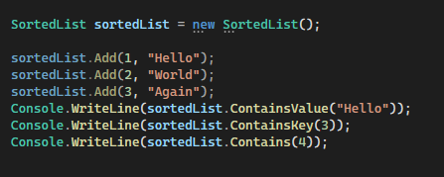
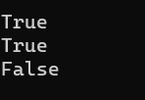

Slide 9
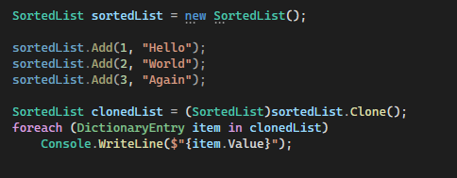

How to Clone the Non-Generic SortedList
If you want to clone or copy the Non-Generic SortedList in C#, then you need to use the following Clone() method provided by the SortedList Collection Class.
Clone(): This method is used to create and return a shallow copy of a SortedList object.

Slide 10
What is the use of the CopyTo method of the Non-Generic SortedList
CopyTo(Array array, int arrayIndex): The CopyTo method of the Non-Generic SortedList Collection Class in C# is used to copy SortedList elements to a one-dimensional Array object, starting at the specified index in the array. Here, the parameter array specifies the one-dimensional Array object that is the destination of the DictionaryEntry objects copied from SortedList. The Array must have zero-based indexing. The arrayIndex parameter specifies the zero-based index in the array at which copying begins. If the parameter array is null, then it will throw ArgumentNullException. If the parameter arrayIndex is less than zero, then it will throw ArgumentOutOfRangeException.

Slide 11
Non-Generic SortedList Collection Class Properties
Keys: Gets the keys in a System.Collections.SortedList object. It returns a System.Collections.ICollection object containing the keys in the System.Collections.SortedList object.
IsSynchronized: Gets a value indicating whether access to a SortedList object is synchronized (thread-safe). It returns true if access to the SortedList object is synchronized (thread-safe); otherwise, false. The default is false.
IsReadOnly: Gets a value indicating whether the SortedList object is read-only. It returns true if the System.Collections.SortedList object is read-only; otherwise, false. The default is false.
IsFixedSize: It returns true if the SortedList object has a fixed size; otherwise, false. The default is false.
Count: It returns the number of elements contained in the System.Collections.SortedList object.
Capacity: It returns the number of elements that the System.Collections.SortedList object can contain.
SyncRoot: It returns an object that can be used to synchronize access to the System.Collections.SortedList object.
Values: Gets the values in a SortedList object. It returns a System.Collections.ICollection object containing the values in the System.Collections.SortedList object.

Slide 12
Summary
The Non-Generic SortedList Collection is a powerful tool for performing quick manipulation of key-value data in an orderly manner. But there are certain scenarios where this class may not be suitable. For example, by its nature, a SortedList must always be sorted. Therefore, whenever we add a new key-value pair to the list or remove a key-value pair from the SortedList, then it must sort itself to ensure that all elements are in the right order. This becomes more expensive as we increase the number of elements in our SortedList.
We should only use SortedList when we want to handle smaller collections that need to be sorted at all times. When dealing with larger collections, it is more efficient to use a dictionary, HashSet, or even a regular list which we can sort when we need it.

